Slide 1

XBOX
Box Storage Management System
CS3343 Software Engineering Practice
Project Group 13

Slide 2
Table of contents
01
02
03
04
05
06
Background
Management
Development
Design
Bug & Test
Interface

Slide 3
01 Background

Slide 4
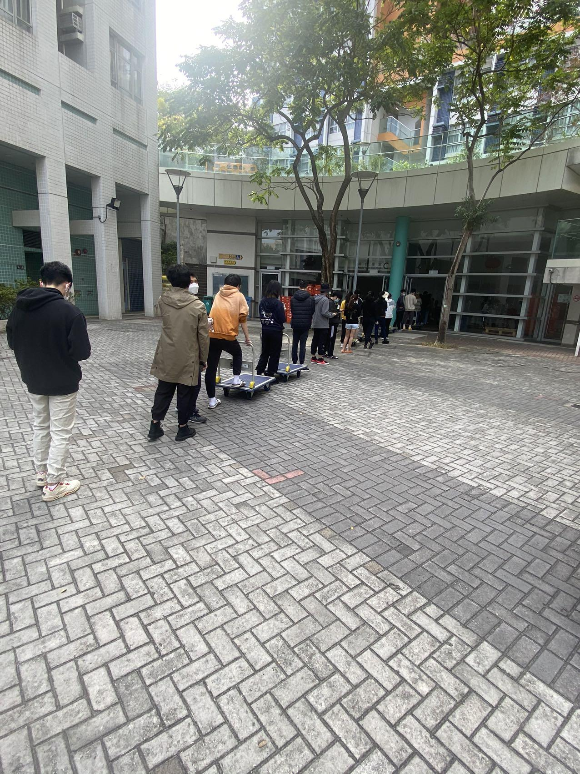
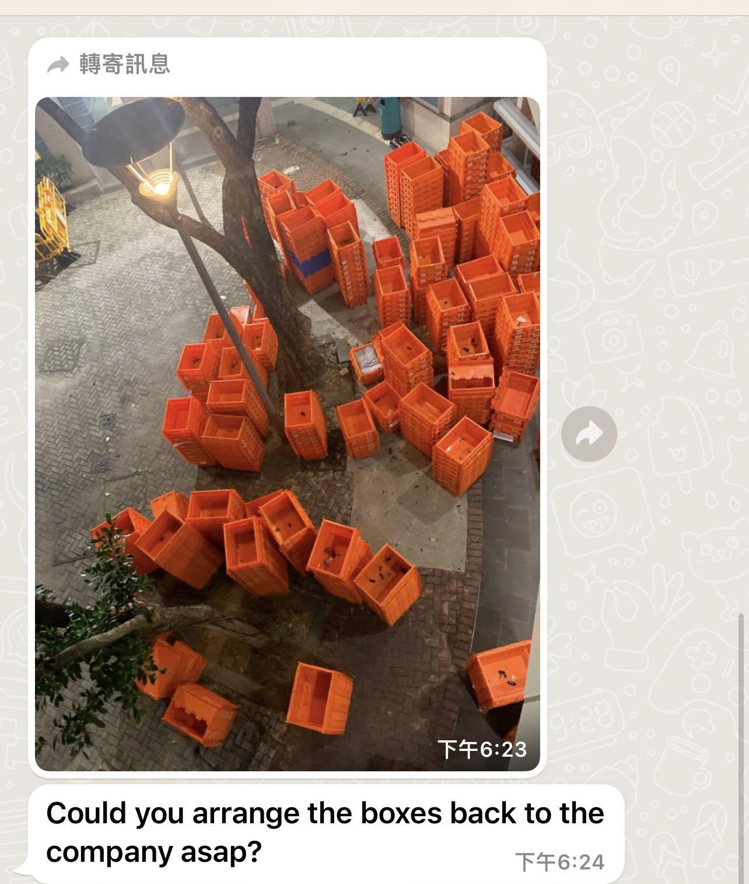

Slide 5


It’s Summer break! I want to go home!
But where should I put my things?

Slide 6
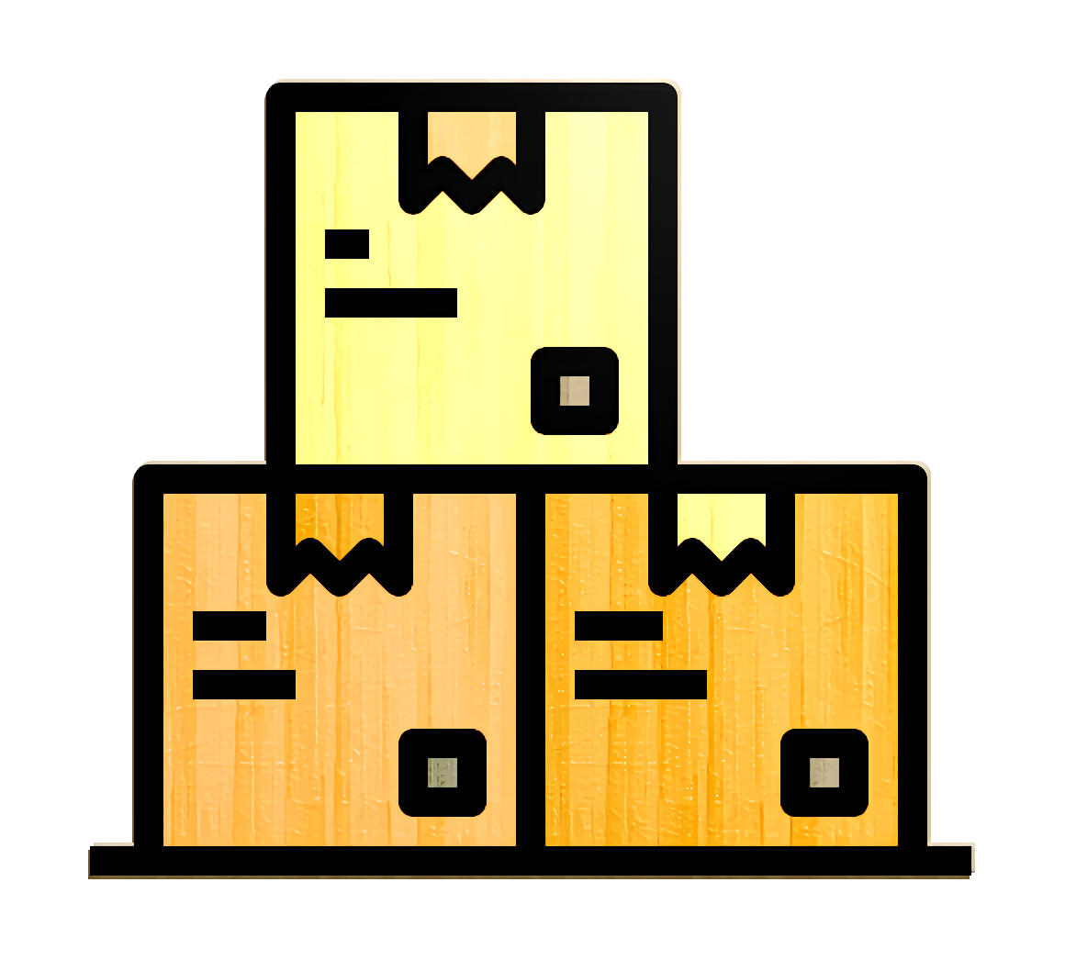
“ XBOX is an storage system supports the storage and payment functions for clients to use and Admin to maintain.”

Slide 7
Our Goal
Admin
User
easy to maintain
easy to check
convenient to use
Immediate situation check

Slide 8
02
Management

Slide 9






Our team
Name | Position | Work Description
SHA Xingchen | Program Developer, Program Tester | Algorithm Core & Testing
ZHOU Yu | Program Developer, Program Tester | Database& Testing
ZHENG Shangkun | Assistant Program Manager Program Developer | Algorithm Core& Database
ZHANG Tiantian | Program Designer, Program Developer | Algorithm Design Principle & Pattern
LI Xiaoyang | Program Manager Program Developer | Data Integration & I/O Module Algorithm Core & Testing
DONG Jiajie | Assistant Program Manager Interface Designer | UI Design & Programming

Slide 10





Tools

Slide 11
Waterfall model
Step 1
Step 3
Step 5
Requirement
Implementation
Maintenance
Step 2
Step 4
Design
Verification

Slide 12
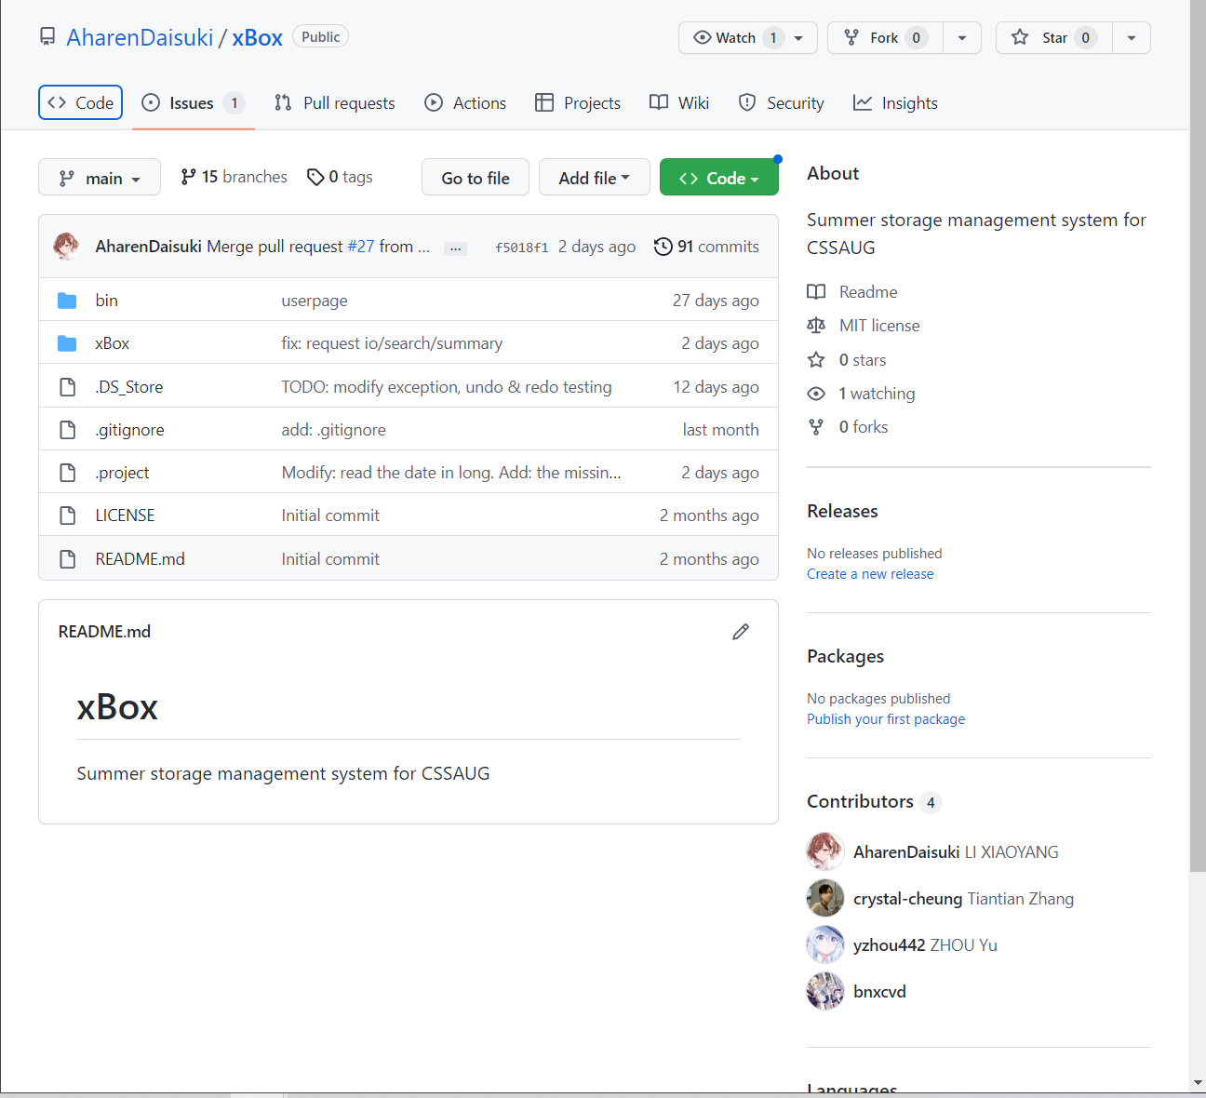

Version Control
Version | New features
1.0 | Command line input and output
2.0 | Adding the GUI component
3.0 | Separate User and Admin Interface

Slide 13
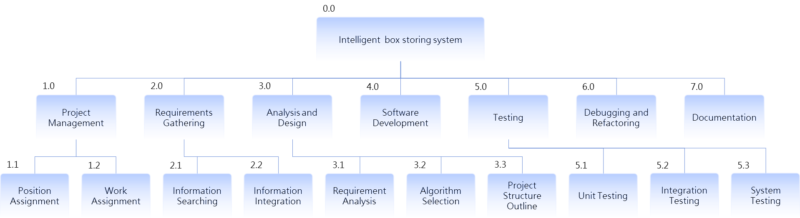
Process schedule

Slide 14
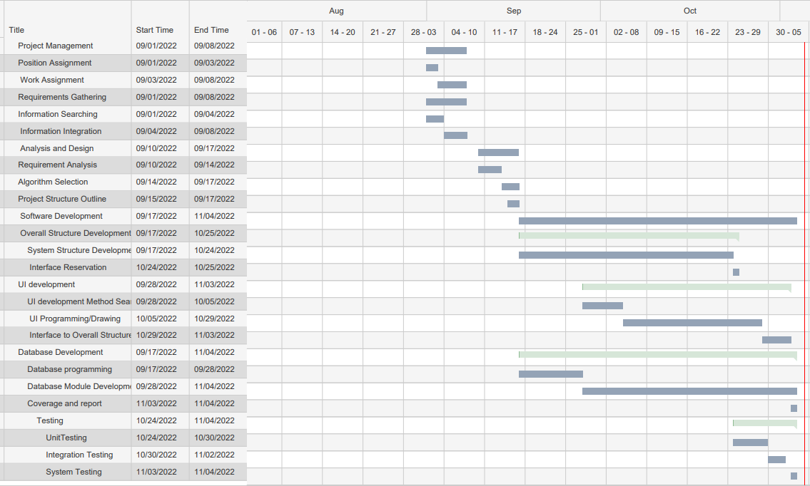
Schedule

Slide 15
03
Development

Slide 16
Program flow
•Back-end data load
•Front-end data input
•Back-end algorithm implementation
•Front-end result display

Slide 17
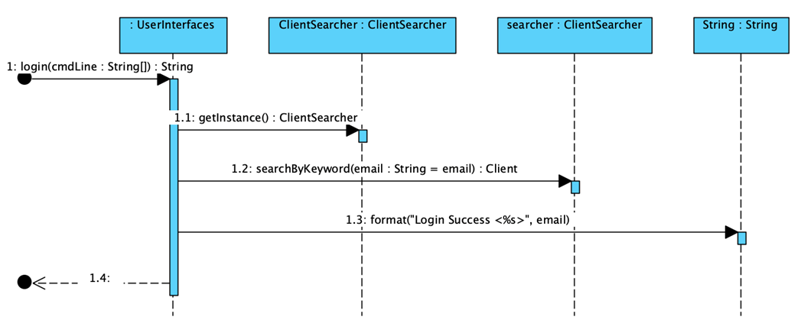

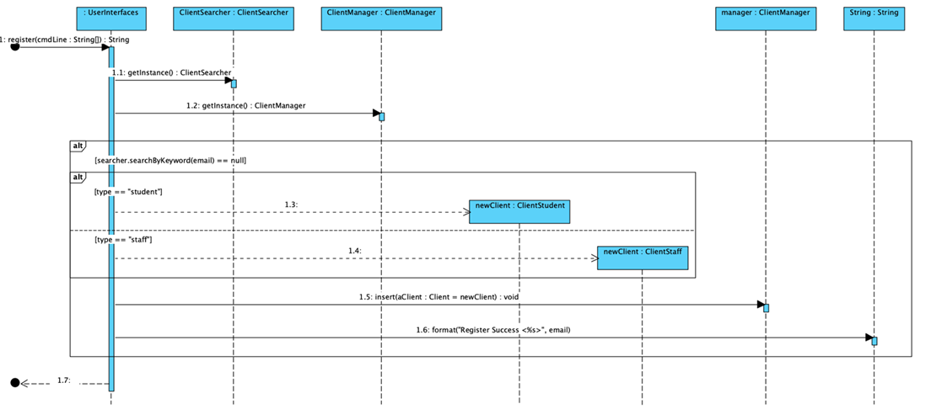
Sequence diagram
Login
Register

Slide 18
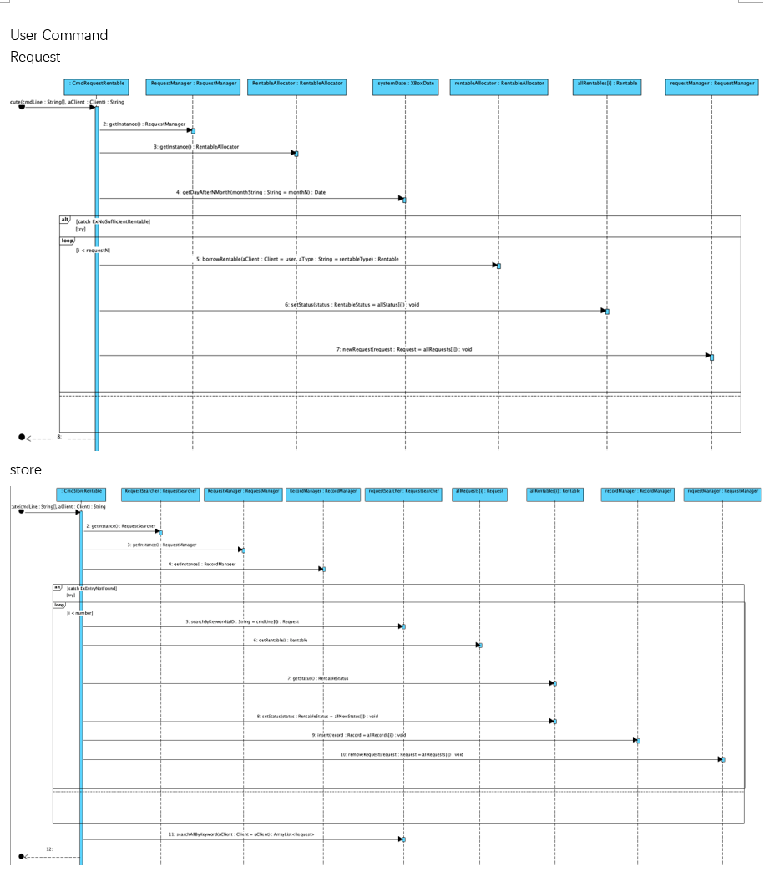
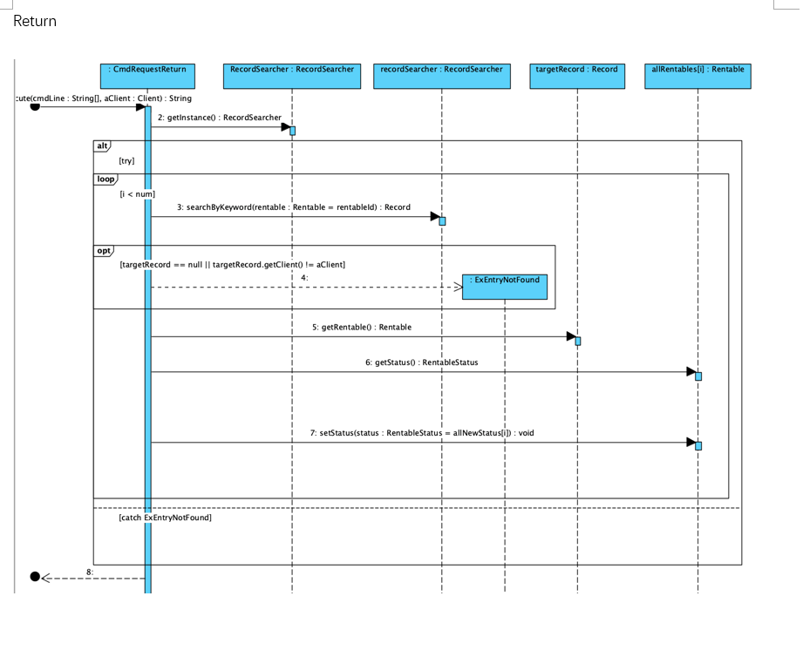

Slide 19
04
Design

Slide 20
Principle
S
O
L
I
D
Single Responsibility Principle
Open-closed principle
Liskov Substitution Principle
Interface Segregation Principle
Dependency Inversion Principle

Slide 21
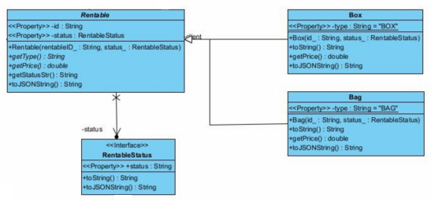
OCP
Open for extension, close for modification.
Notes:
open for extension, but closed for modification

Slide 22
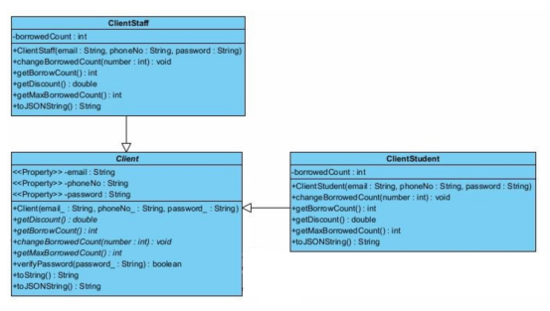
An instance of the super class and another instance of its subclass must be interchangeable without breaking the program.
LSP
Notes:
An instance of the super class and another instance of its subclass must be interchangeable without breaking the program.

Slide 23
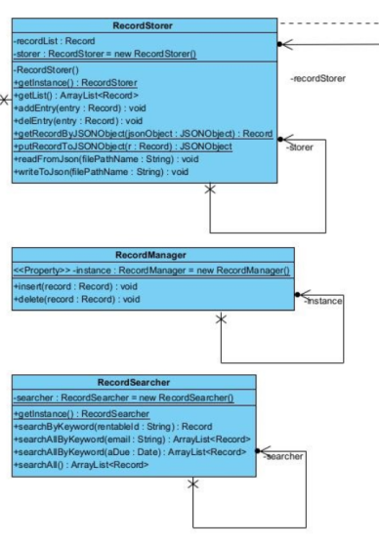
SRP
Every class, module, or function in a program should have one responsibility in a program.
Notes:
every class should have only one reason to change

Slide 24
• High-level modules should not import anything from low level modules. Both should depend on abstractions.
• Abstractions should not depend on details. Concrete implementations should depend on abstractions.
D
I
P
Notes:
In object-oriented design, we emphasize that:
• High-level modules should not import anything from low level modules. Both should depend on abstractions.
• Abstractions should not depend on details. Concrete implementations should depend on abstractions.

Slide 25
Pattern
State Pattern
Command Pattern
Facade Pattern
Singleton Pattern

Slide 26
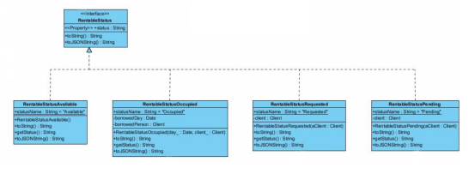
State Pattern
Allow an object to alter its behaviour when its internal state changes.
Notes:
In object-oriented design, we emphasize that:
• High-level modules should not import anything from low level modules. Both should depend on abstractions.
• Abstractions should not depend on details. Concrete implementations should depend on abstractions.

Slide 27
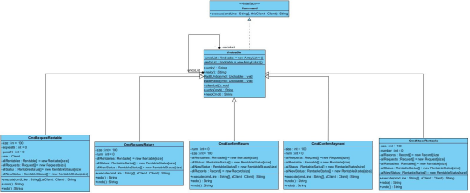
Command Pattern
Allow clients to issue different requests with ease and saving requests in a queue for reference.
Notes:
In object-oriented design, we emphasize that:
• High-level modules should not import anything from low level modules. Both should depend on abstractions.
• Abstractions should not depend on details. Concrete implementations should depend on abstractions.

Slide 28
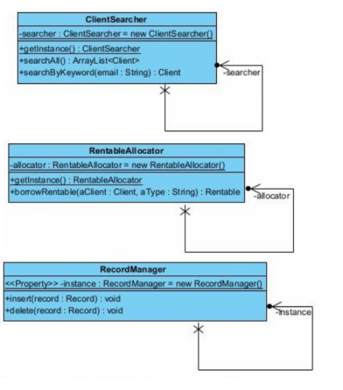
Singleton Pattern
Reduce the number of duplicated objects being created
Notes:
In object-oriented design, we emphasize that:
• High-level modules should not import anything from low level modules. Both should depend on abstractions.
• Abstractions should not depend on details. Concrete implementations should depend on abstractions.

Slide 29
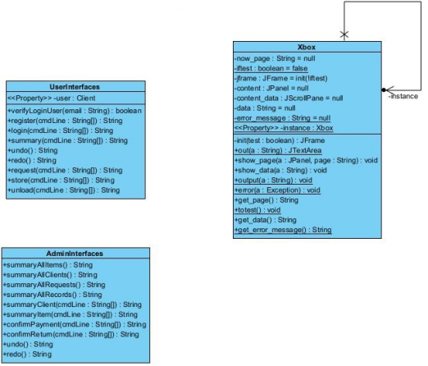
Facade Pattern
serves as a front-facing interface masking more complex underlying or structural code.
Notes:
In object-oriented design, we emphasize that:
• High-level modules should not import anything from low level modules. Both should depend on abstractions.
• Abstractions should not depend on details. Concrete implementations should depend on abstractions.

Slide 30
05
Bug&Test

Slide 31

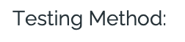


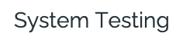

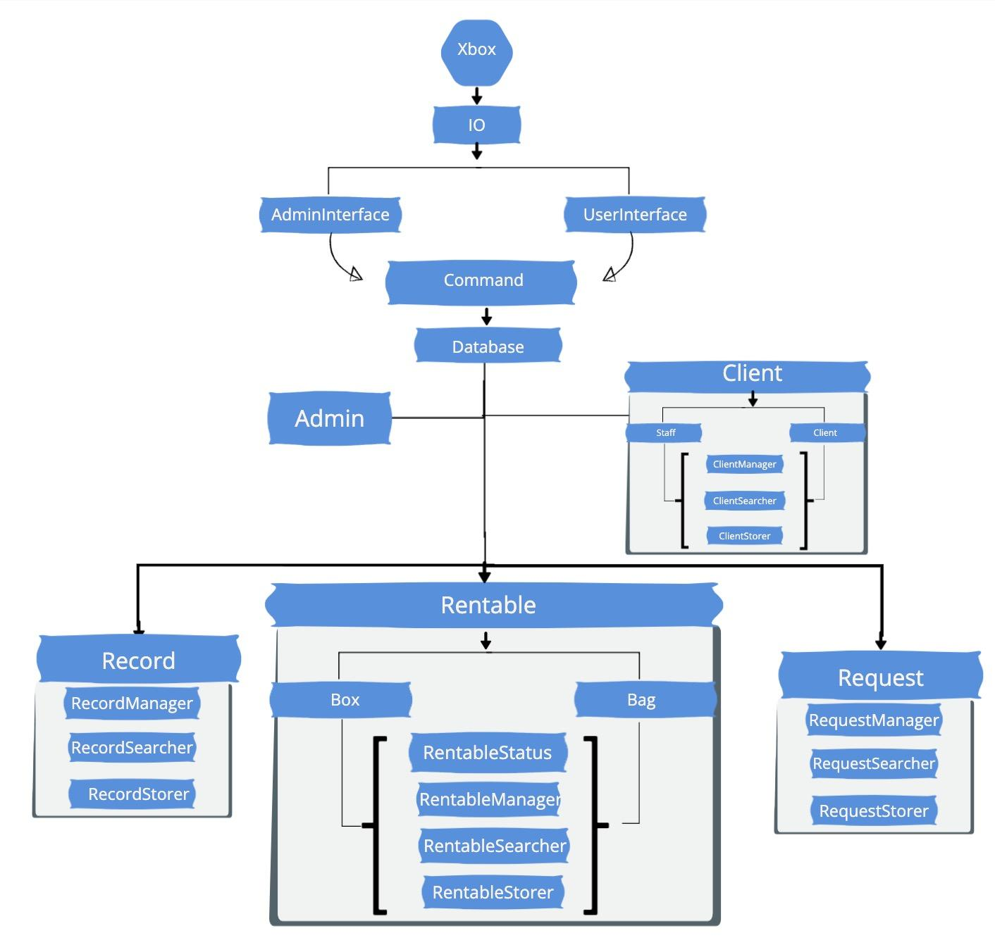
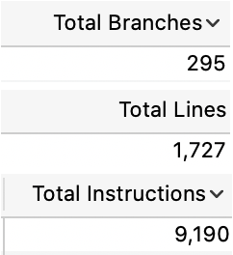


Slide 32
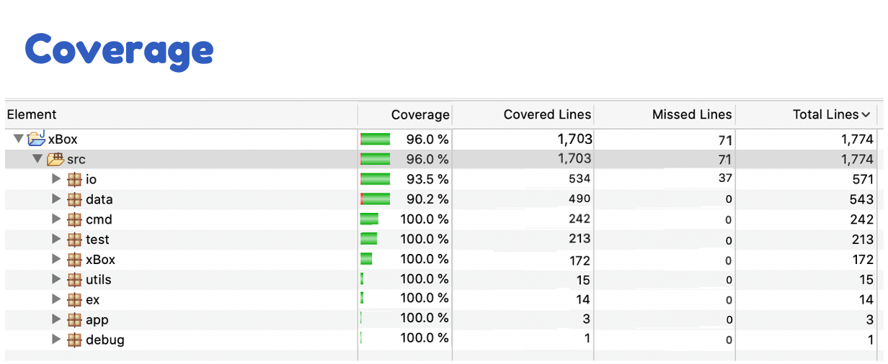
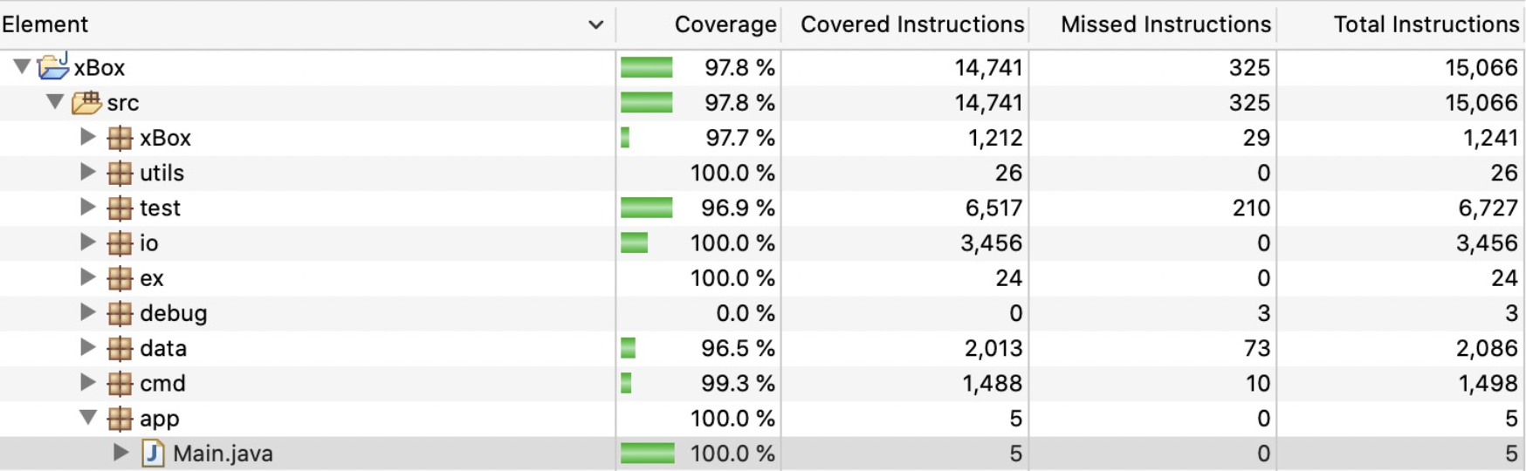

Slide 33

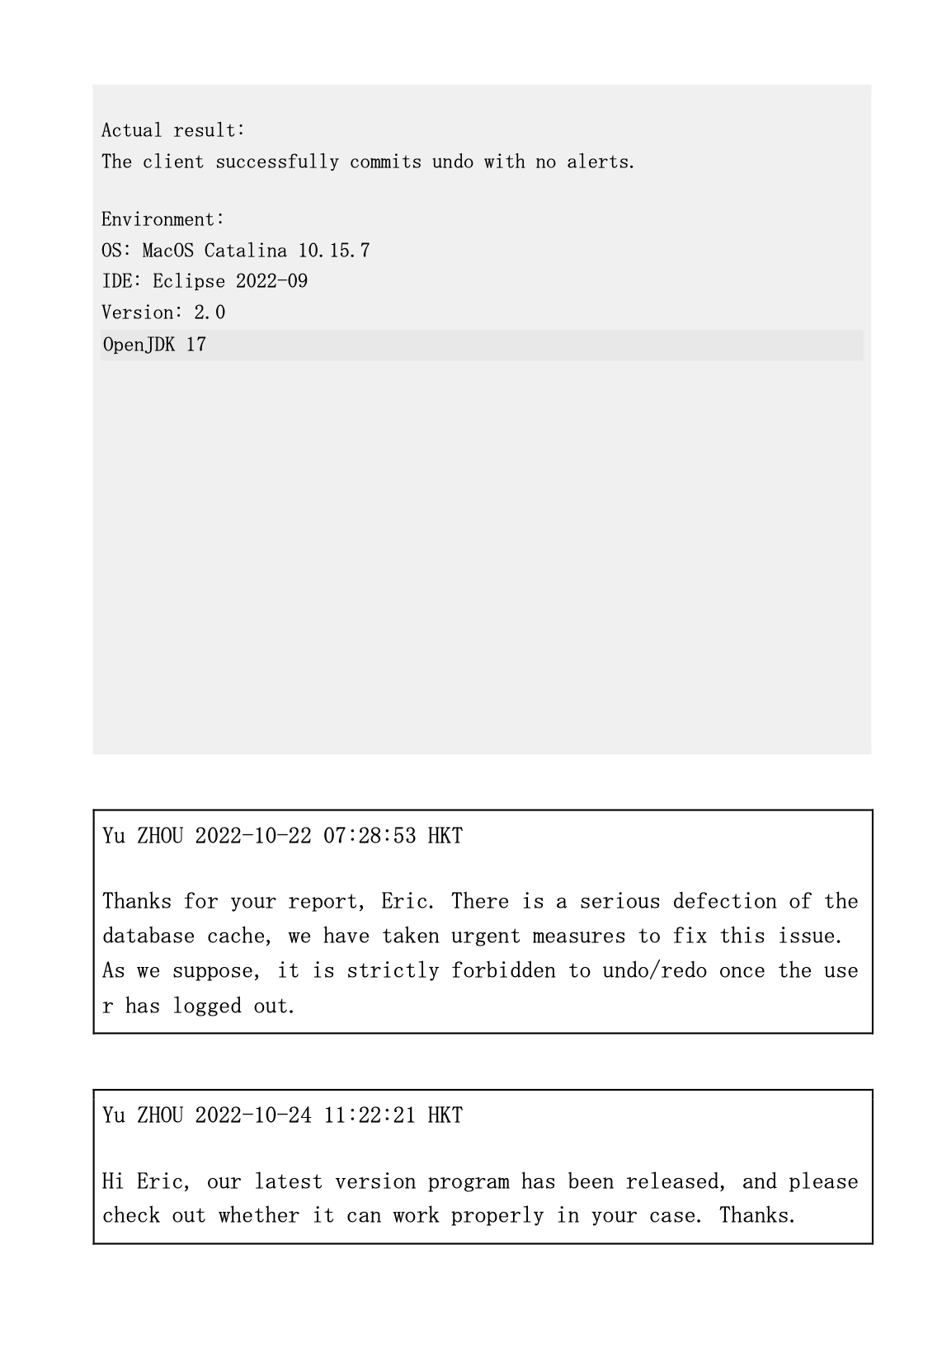
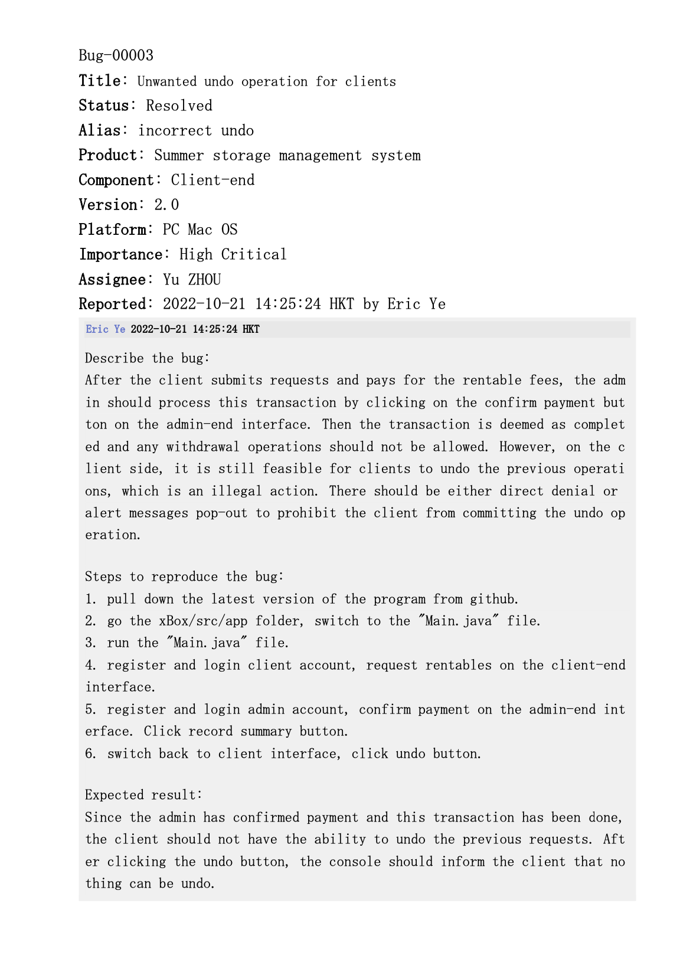
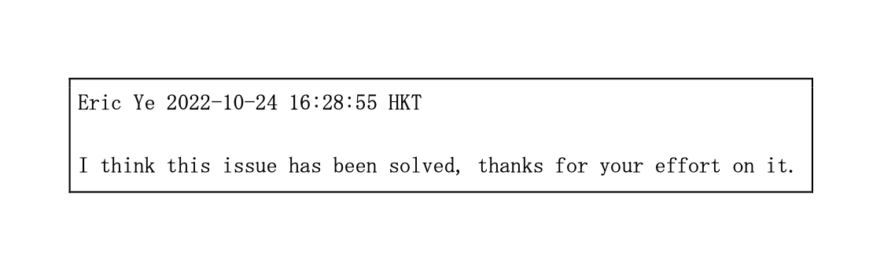
Bugzilla
­A good platform to debug
­Timely communication between reporter and assignee
­Clear responsibility assignment
Convenient debugging history review

Slide 34
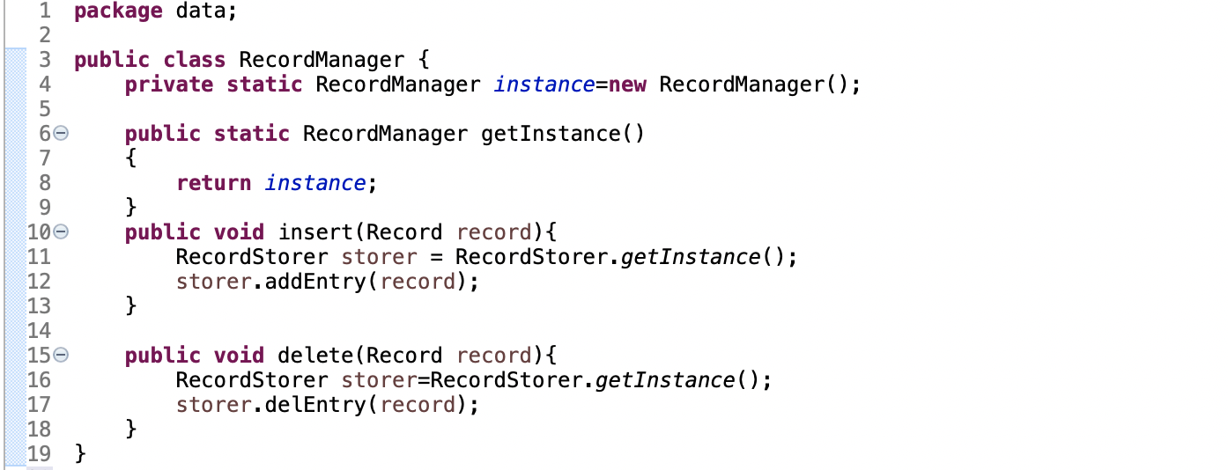
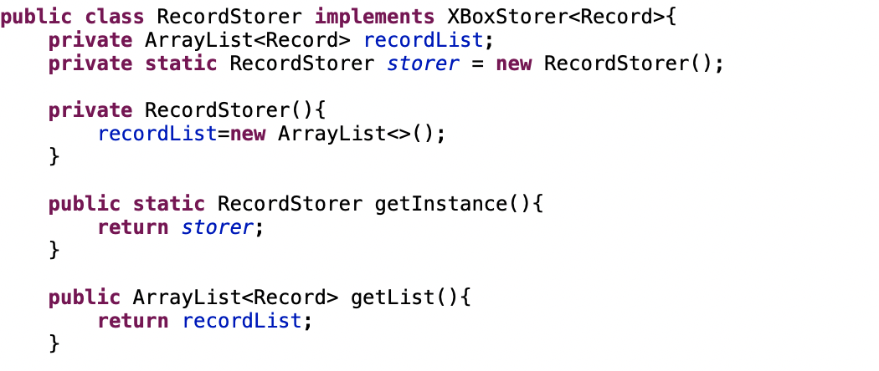
Refactoring
Example 1
private ArrayList<Record> recordList
Separate recordList from RecordManager
Maintain good isolation between two classes
Make data storing and loading much clearer
Implementation of SRP

Slide 35
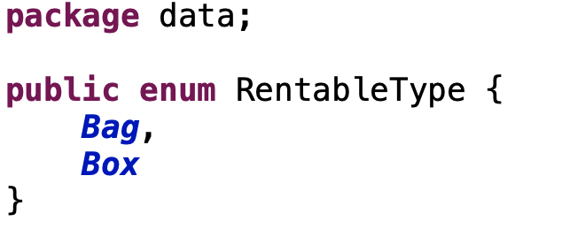
Refactoring
Example 2
Box.getInstance()
->
RentableType.Box
Singleton class to enumerate class;
Avoid the usage of “instanceof”

Slide 36
06
Interface

Slide 37
xBox
User Interface
User-friendly

Slide 38
User persona
Age: 18-25
Occupation: Student
Income: lower middle
Location: Hong Kong
Requirements
Demands
Easy to use
No prerequisite and skills needed
Robust & Stable
Storage demands during summer break
Reliability & Traceable transaction

Slide 39
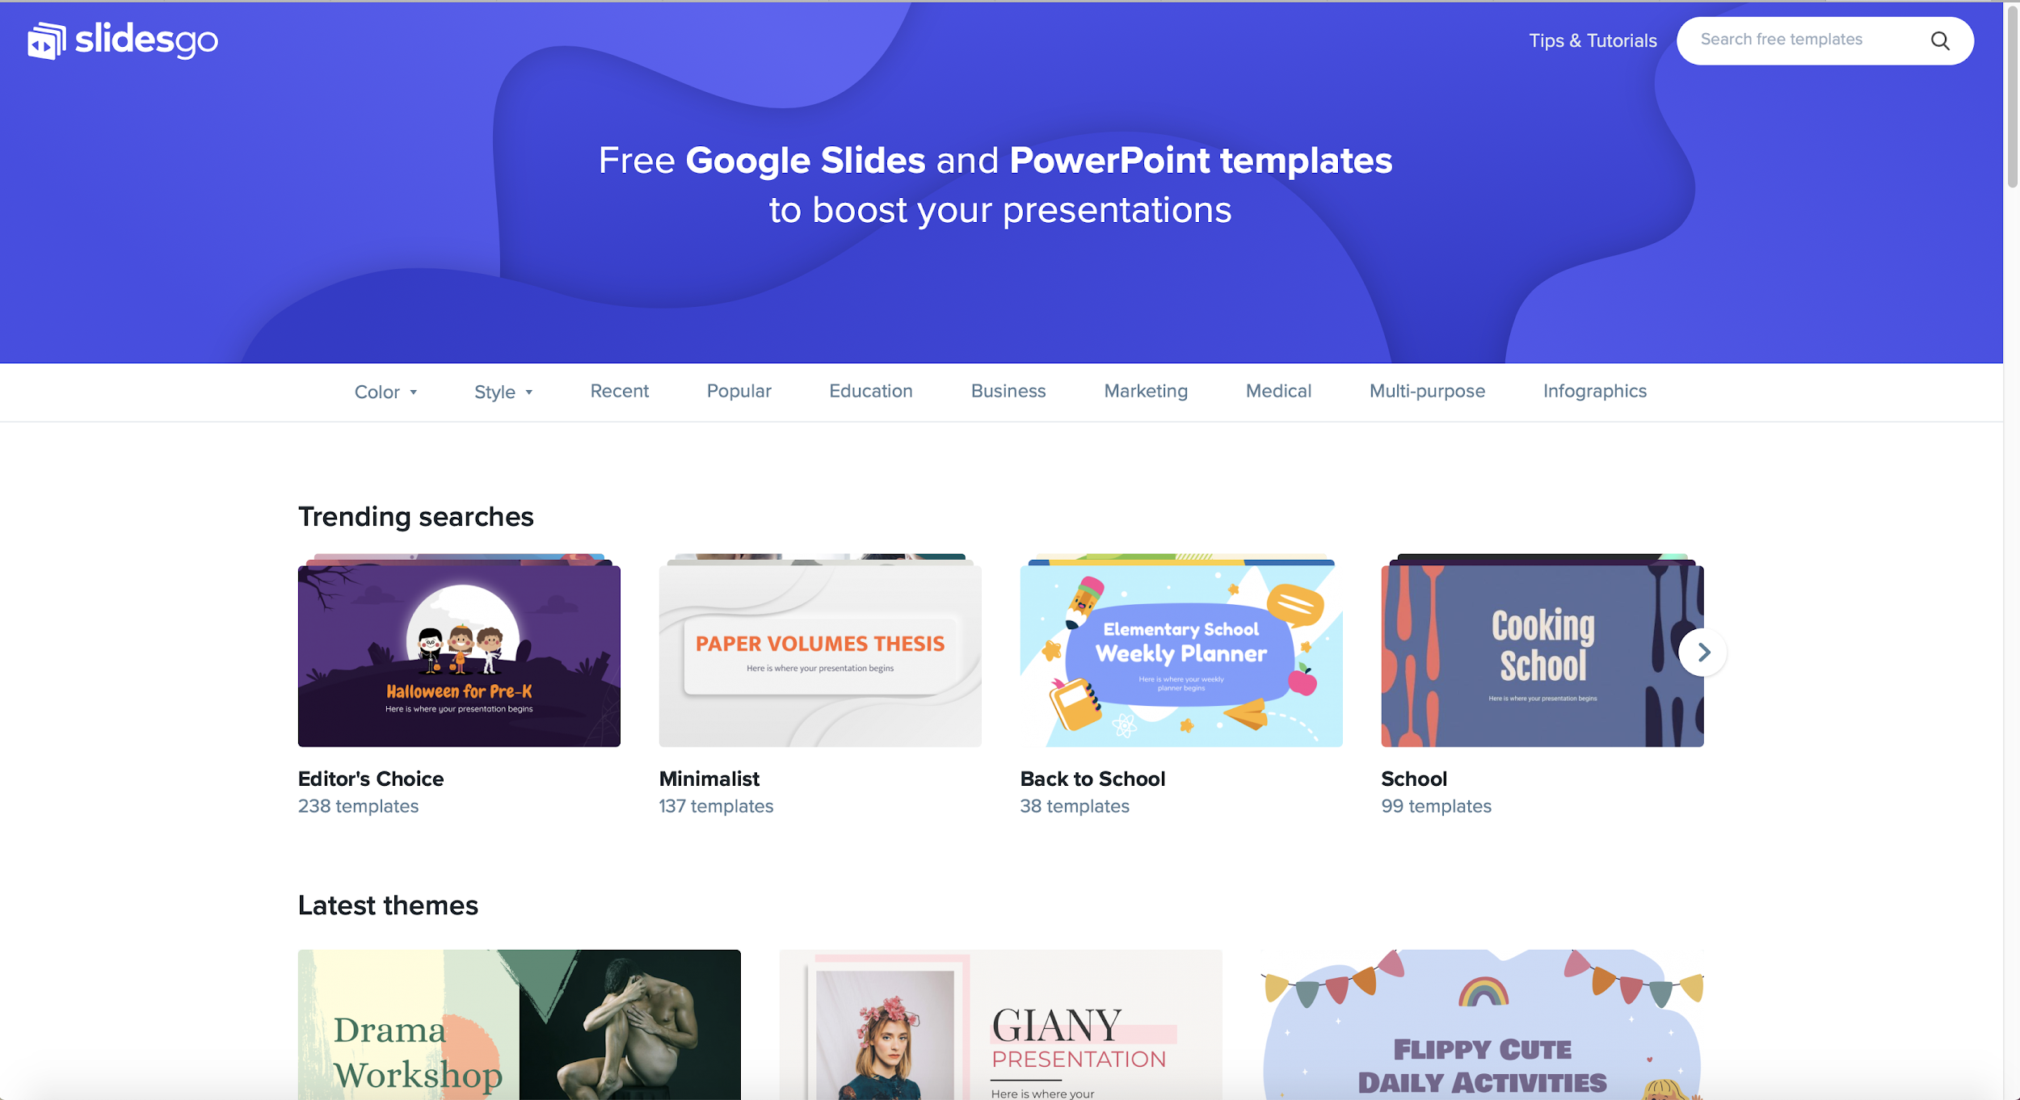
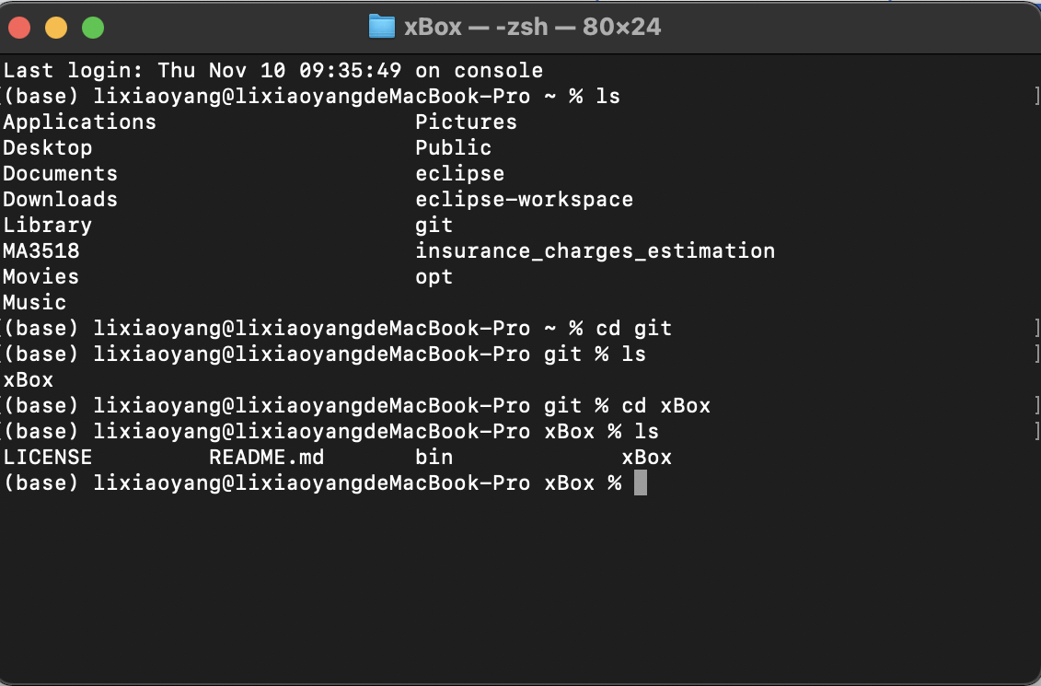
Desktop software?
Complex instructions?
User Manual?

Slide 40
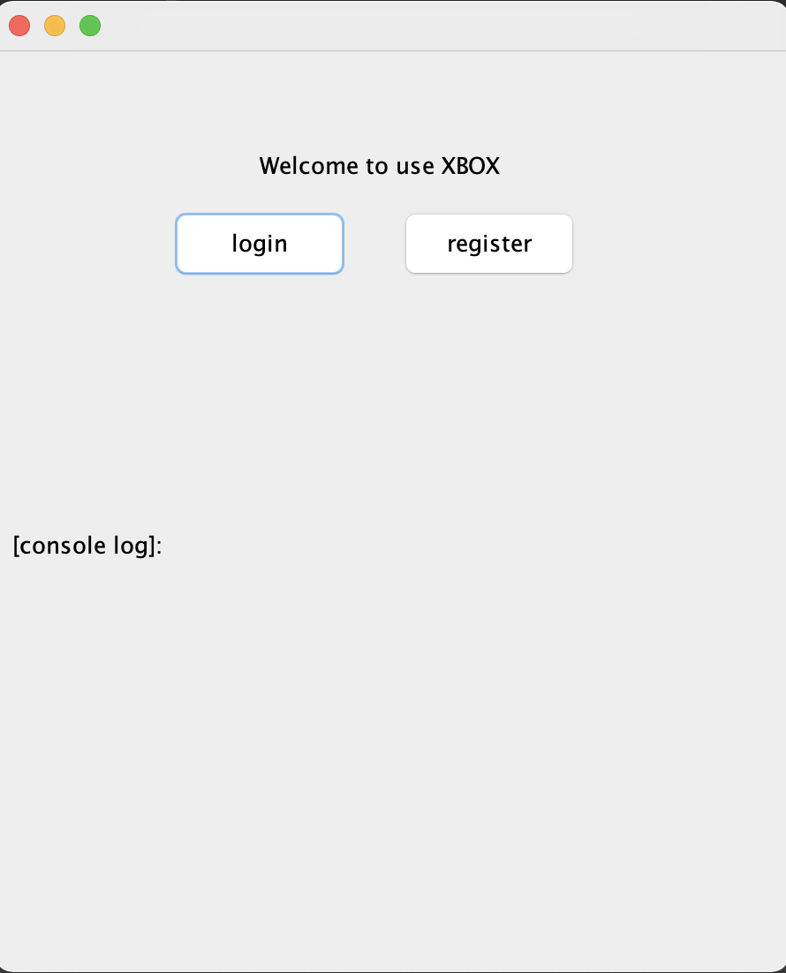

Tablet app
This is how our tablet UI looks like when signing in and signing up.

Slide 41

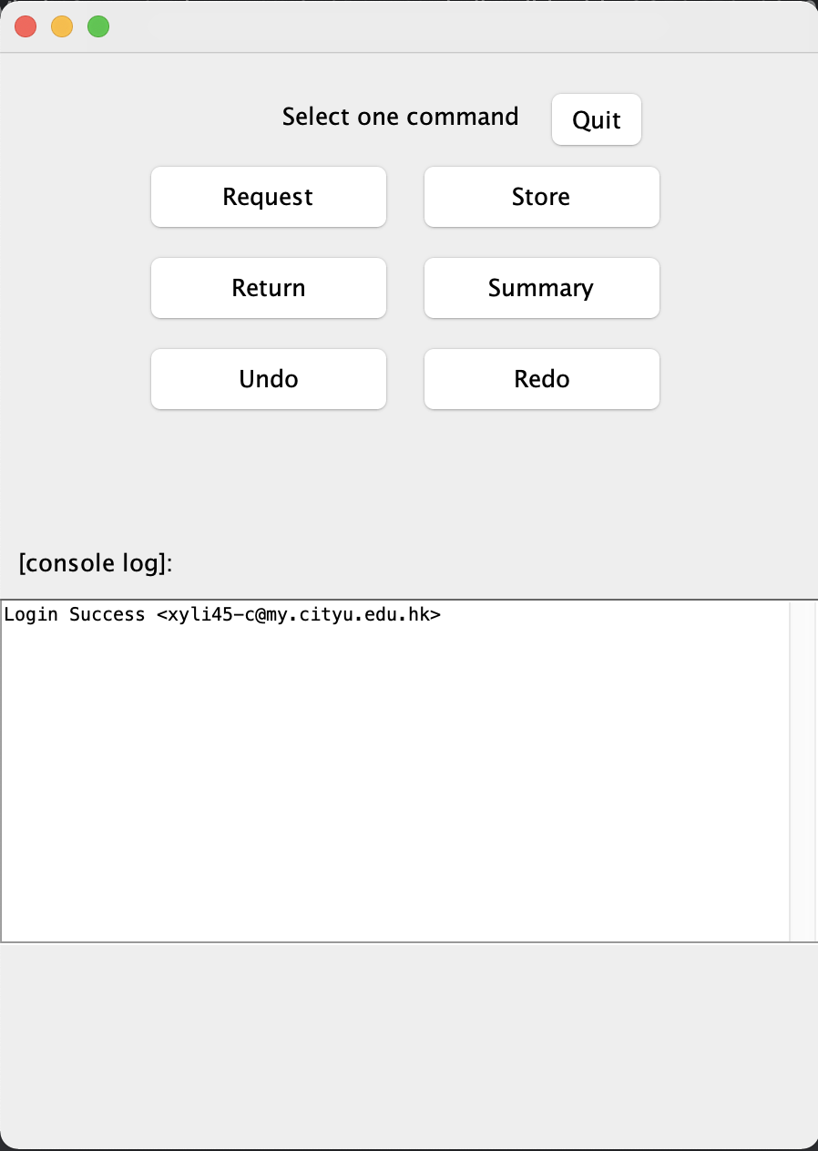
Mobile web
This is how interfaces provided for users looks like on your mobile device. You can access to our services conveniently.

Slide 42
Time to demonstrate…
User functions
Request >
Reserve your bookings
Return >
Send notifications
Store >
Store your items
Summary >
Check your item info
Undo&Redo >
Never mind if you made mistakes!

Slide 43
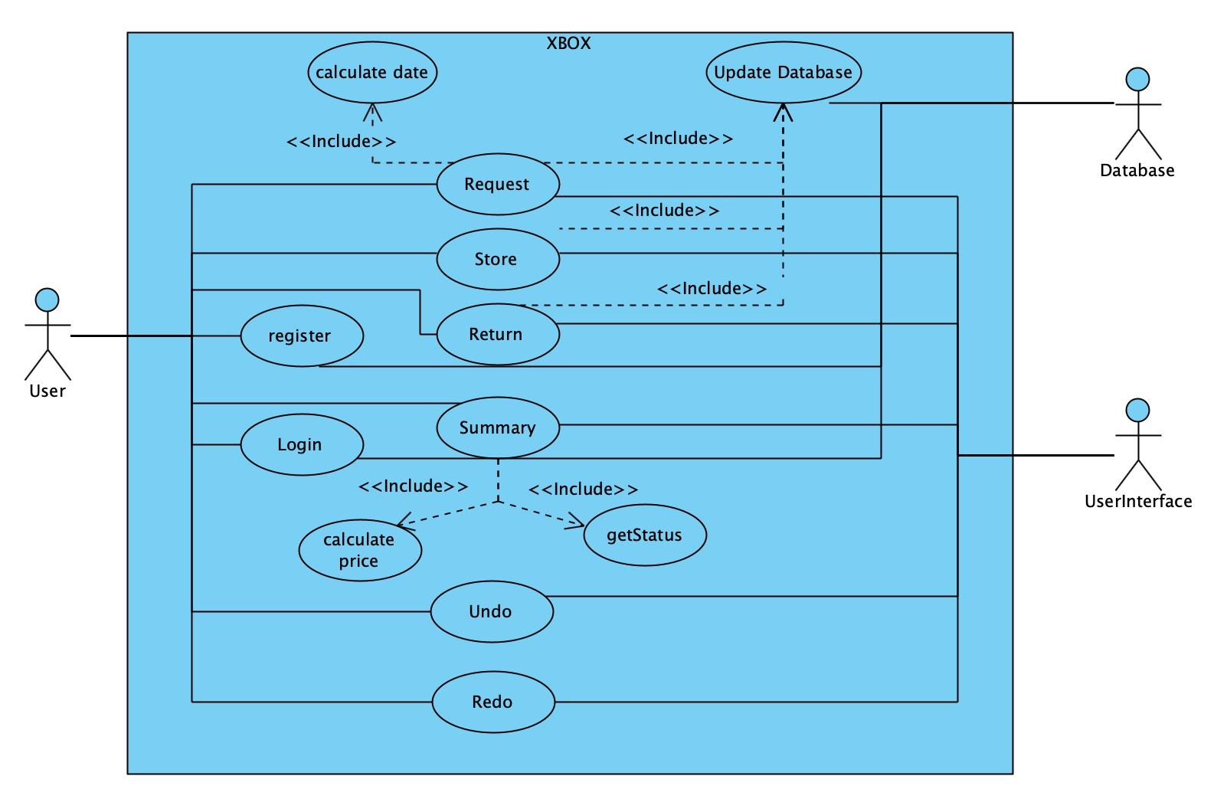
Use Case Scenario
Notes:
In object-oriented design, we emphasize that:
• High-level modules should not import anything from low level modules. Both should depend on abstractions.
• Abstractions should not depend on details. Concrete implementations should depend on abstractions.

Slide 44
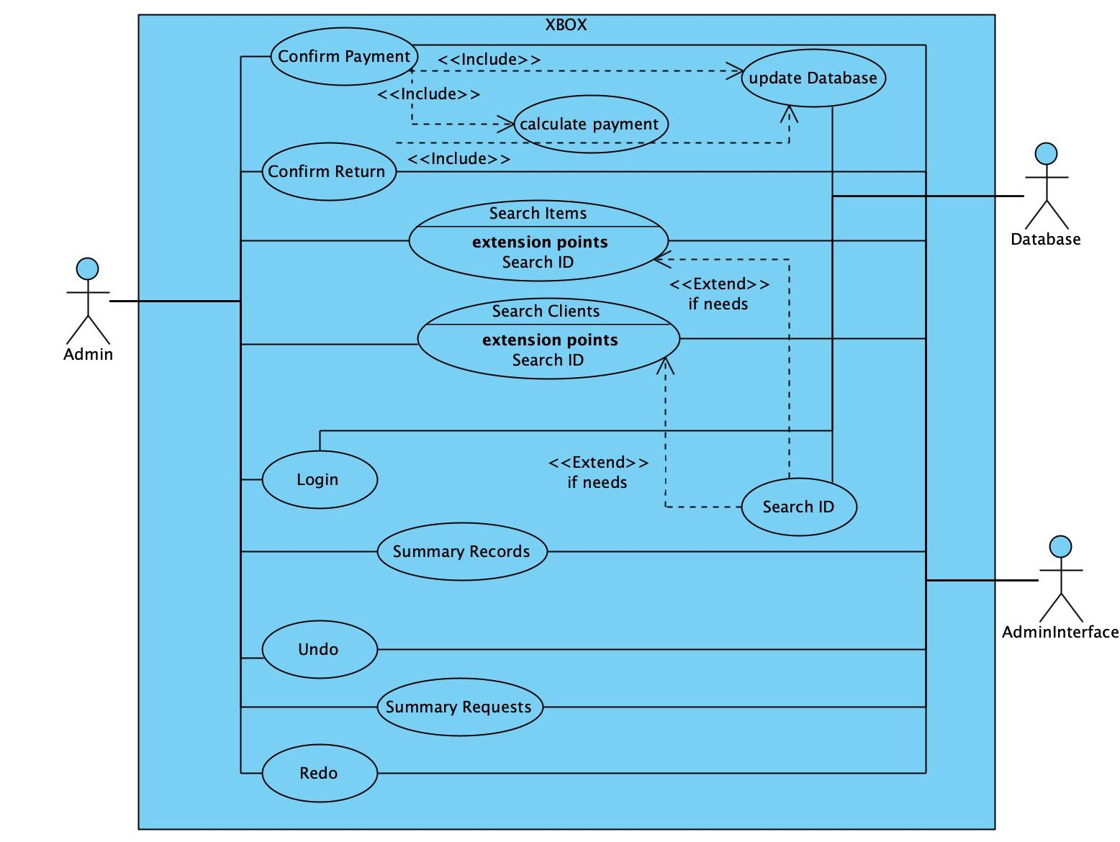
Use Case Scenario
Notes:
In object-oriented design, we emphasize that:
• High-level modules should not import anything from low level modules. Both should depend on abstractions.
• Abstractions should not depend on details. Concrete implementations should depend on abstractions.

Slide 45
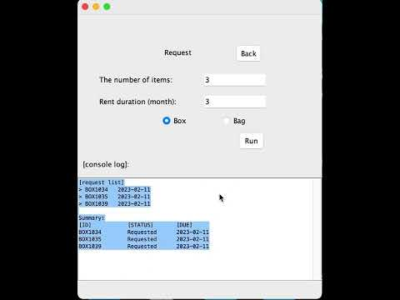
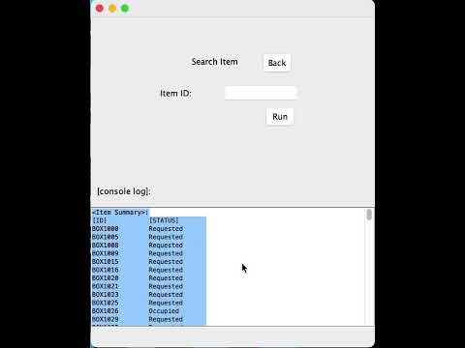
Workflow - transaction process
Together with other user functions, let’s see how a transaction will be done in real interaction!
User scenario
Admin scenario

Slide 46

Thanks
Do you have any questions?
Collaborators
DONG JIAJIE https://github.com/dongjiajiedc
LI XIAOYANG https://github.com/AharenDaisuki
SHA XINGCHEN https://github.com/rocksxc
ZHENG SHANGKUN https://github.com/bnxcvd
ZHOU YU https://github.com/yzhou442
ZHANG TIANTIAN https://github.com/crystal-cheung

